Slide 1
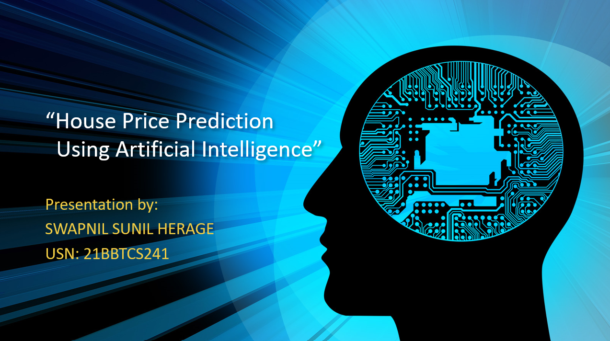
“House Price Prediction Using Artificial Intelligence”
Presentation by:
SWAPNIL SUNIL HERAGE
USN: 21BBTCS241

Slide 2
Problem Statement
Thousands of houses are sold everyday. There are some questions every buyer asks him self like: What is actual price that this house deserve ?Am I paying a fair price

Slide 3
Introduction
House price prediction are very stressful work as we have to consider different things while buying house like the structure and the rooms kitchen parking space and garden
People don’t know about the factor which influence the house price. But by using the machine learning we can easily find the house which is to be perfect foe us and helps to predict the price accurately

Slide 4
Important Libraries and Dateset
Here we are using
• Pandas – To load the Data frame
• Matplotlib – To visualize the data features i.e. bar plot
• Seaborn – To see the correlation between features using heatmap

Slide 5
Steps Involved during Construction of Project
Data Description
Data Preprocessing
Exploratory Data Analysis
Data Cleaning

Slide 6
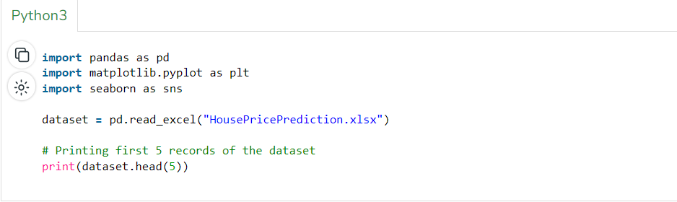
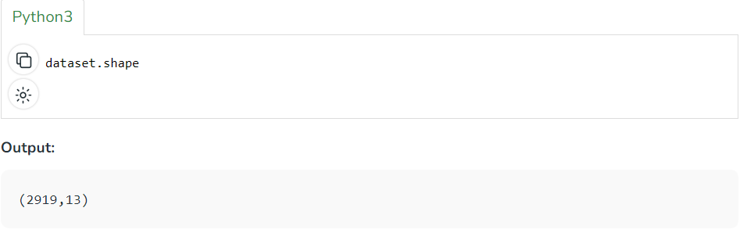
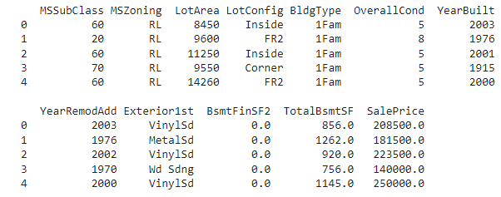
How it works?
A. Data Description

Slide 7
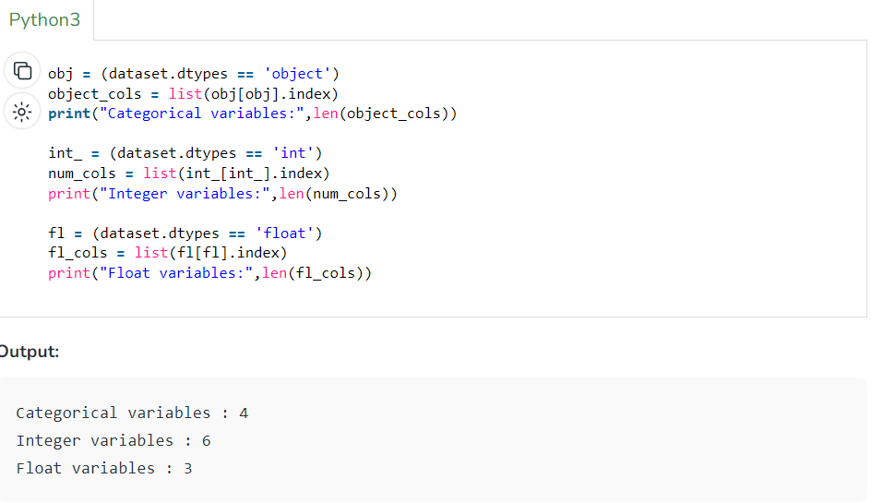
B. Data Preprocessing

Slide 8
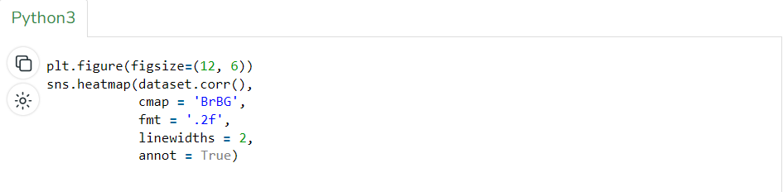
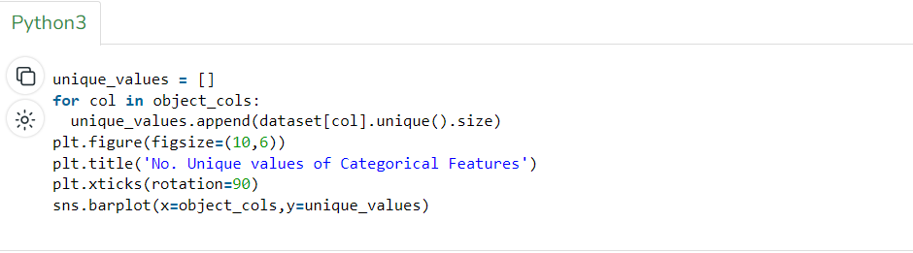
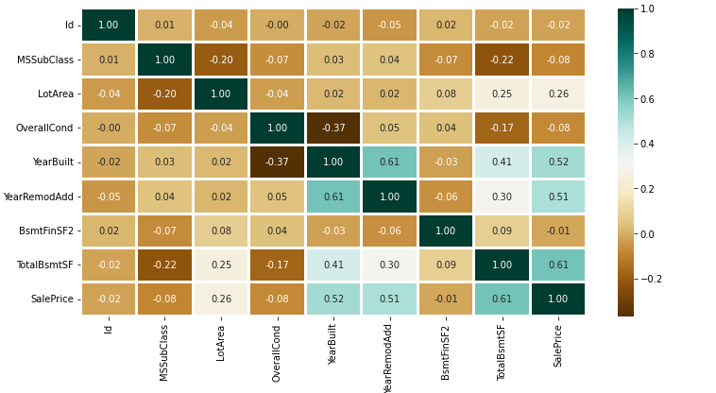
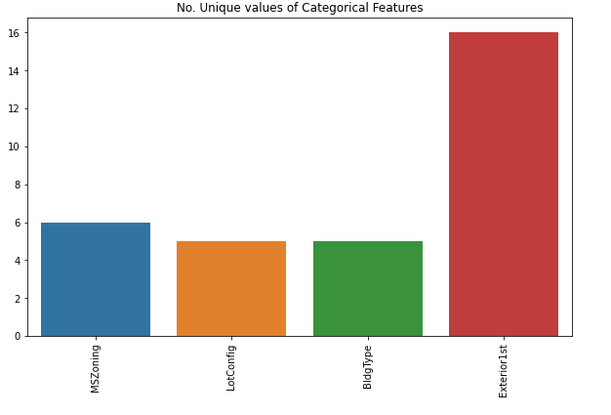
c. Exploratory Data Analysis

Slide 9
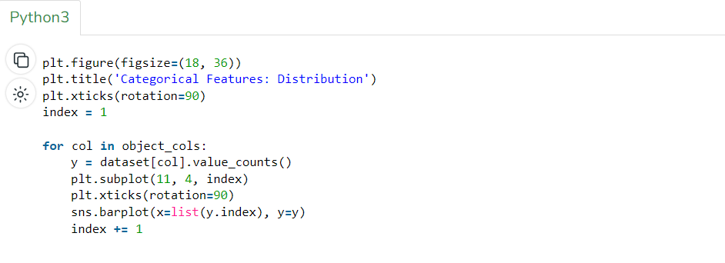
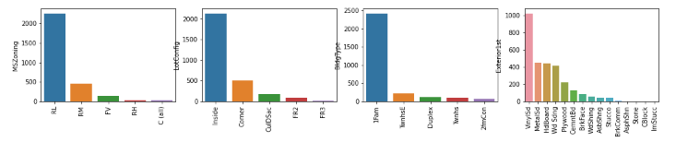

Slide 10
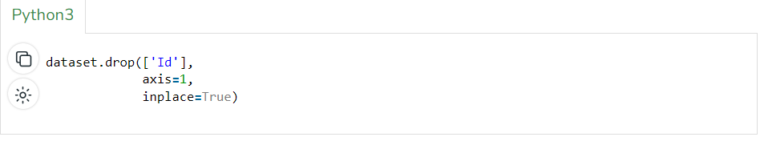
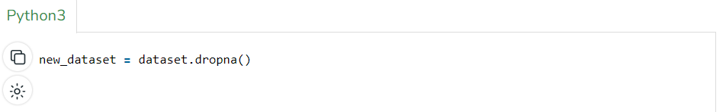
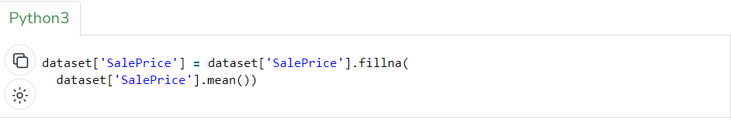
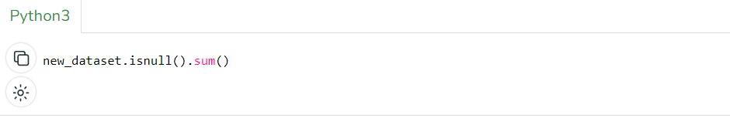
D. Data Cleaning

Slide 11


